Slide 1
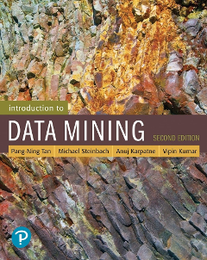
Chapter Four: K-Nearest Neighbor & Logistic Regression
CSCE 5380/4380 – Data Mining

Slide 2
Outline
Nearest Neighbor Classifiers
K-NN: Algorithms
Characteristics of K-NN
Logistic Regression
Learning a Logistic Regression Model
Characteristics of Logistic Regression
Introduction to Data Mining, 2nd Edition

Slide 3
Nearest Neighbor Classifiers
Basic idea:
If it walks like a duck, quacks like a duck, then it’s probably a duck
Compute Distance
Test Record
Training Records
Choose k of the “nearest” records

Slide 4
Nearest Neighbor Classifiers
The k-nearest neighbors of a given test instance z refer to the k training examples that are closest to z
Requires the following:
A set of labeled records
Proximity metric to compute distance/similarity between a pair of records
e.g., Euclidean distance
The value of k, the number of nearest neighbors to retrieve
A method for using class labels of K nearest neighbors to determine the class label of unknown record (e.g., by taking majority vote)

Slide 5
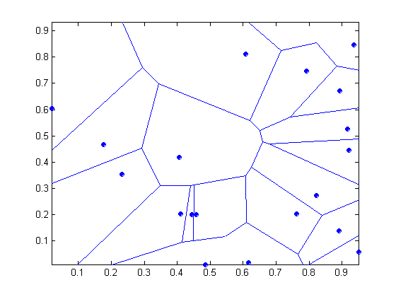
Nearest Neighbor classifiers
Nearest neighbor classifiers are know as Lazy Learners (Strategy of delaying the process of modeling the training data until it is needed to classify the test instances)
Nearest neighbor classifiers are local classifiers
They can produce decision boundaries of arbitrary shapes.
1-nn decision boundary is a Voronoi Diagram

Slide 6
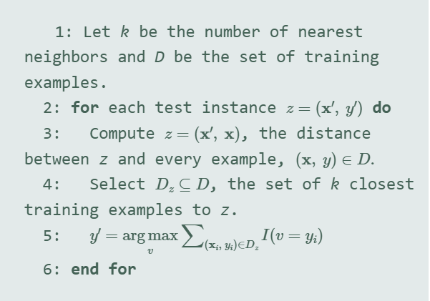
K-NN: Algorithms

Slide 7

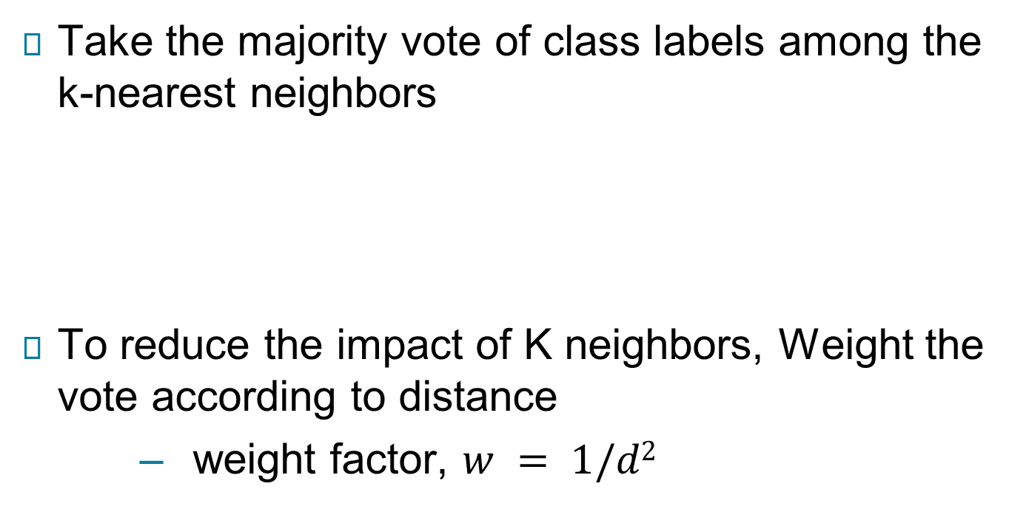
How to Determine the class label of a Test Sample?
Take the majority vote of class labels among the k-nearest neighbors
To reduce the impact of K neighbors, Weight the vote according to distance
weight factor, $w = 1/d2$

Slide 8
Choice of proximity measure matters
For documents, cosine is better than correlation or Euclidean
1 1 1 1 1 1 1 1 1 1 1 0
0 0 0 0 0 0 0 0 0 0 0 1
vs
0 1 1 1 1 1 1 1 1 1 1 1
1 0 0 0 0 0 0 0 0 0 0 0
Euclidean distance = 1.4142 for both pairs, but the cosine similarity measure has different values for these pairs.

Slide 9
Nearest Neighbor Classification…
Choosing the value of k:
If k is too small, sensitive to noise points (overfitting)
If k is too large, neighborhood may include points from other classes (misclassification)

Slide 10
Nearest Neighbor Classification…
Data preprocessing is often required
Attributes may have to be scaled to prevent distance measures from being dominated by one of the attributes
Example:
height of a person may vary from 1.5m to 1.8m
weight of a person may vary from 90lb to 300lb
income of a person may vary from $10K to $1M
Time series are often standardized to have 0 means a standard deviation of 1

Slide 11
Nearest Neighbor Classification…
How to handle missing values in training and test sets?
Proximity computations normally require the presence of all attributes
Some approaches use the subset of attributes present in two instances
This may not produce good results since it effectively uses different proximity measures for each pair of instances
Thus, proximities are not comparable

Slide 12
Characteristics of K-NN
K-NN is part of instance-based learning, which uses the training examples to make predictions for a test instance.
Nearest neighbor classifiers make their predictions based on local information and can produce decision boundaries of arbitrary shape.
Nearest neighbor classifiers have difficulty handling missing values in both the training and test sets since proximity computations normally require the presence of all attributes.
Nearest neighbor classifiers can handle the presence of interacting attributes, but the presence of irrelevant and redundant attributes can adversely affect the performance of nearest neighbor classifiers.
K-NN can produce wrong predictions unless the appropriate proximity measure and data preprocessing steps are taken.

Slide 13
Logistic Regression
Logistic regression is a classification algorithm used to assign observations to a discrete set of classes (e.g. to classify instances, in some classification problems, to Email spam or not spam, Online transactions Fraud or not Fraud, Tumor Malignant or Benign).
Logistic regression transforms its output using the logistic (sigmoid) function to return a probability value.
logistic regression is a probabilistic discriminative model, which directly estimates the odds of a data instance x using its attribute values.

Slide 14
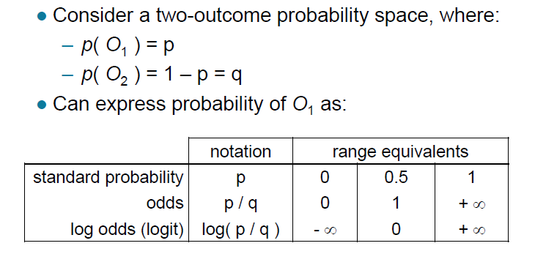
Different ways of expressing probability

Slide 15
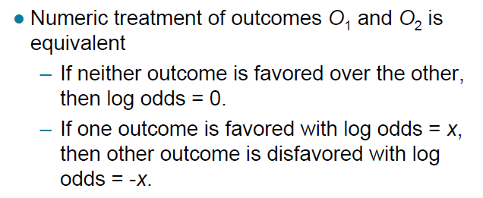
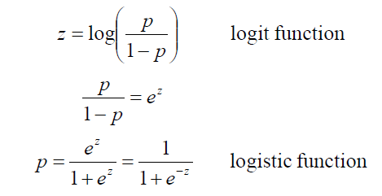
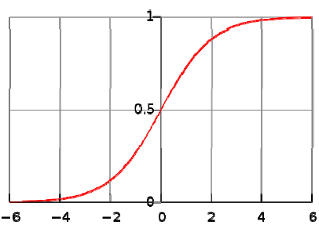
Log odds (logit function) & logistic function

Slide 16
Logistic Regression: The Scenario
A multidimensional feature space (features
can be categorical or continuous).
Outcome is discrete, not continuous.
We’ll focus on case of two classes.
It seems plausible that a linear decision
boundary (hyperplane) will give good
predictive accuracy.

Slide 17
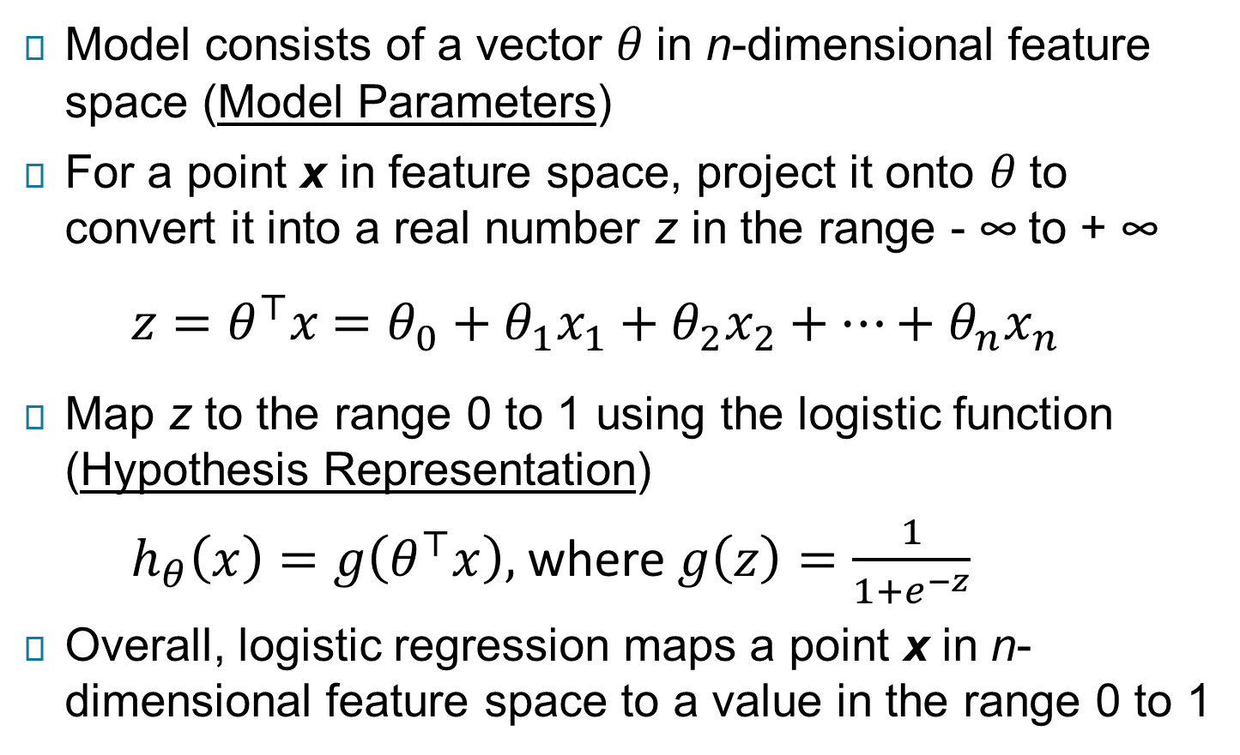
Logistic Regression: The Idea
Model consists of a vector $θ$ in n-dimensional feature space (Model Parameters)
For a point x in feature space, project it onto $θ$ to convert it into a real number z in the range - ∞ to + ∞
$z=θ^{⊤}x$ $=θ_{0}+θ_{1}x_{1}+θ_{2}x_{2}+⋯+θ_{n}x_{n}$
Map z to the range 0 to 1 using the logistic function (Hypothesis Representation)
$h_{θ}\left(x\right)=g\left(θ^{⊤}x\right),$ where $g\left(z\right)=\frac{1}{1+e^{−z}}$
Overall, logistic regression maps a point x in n- dimensional feature space to a value in the range 0 to 1

Slide 18
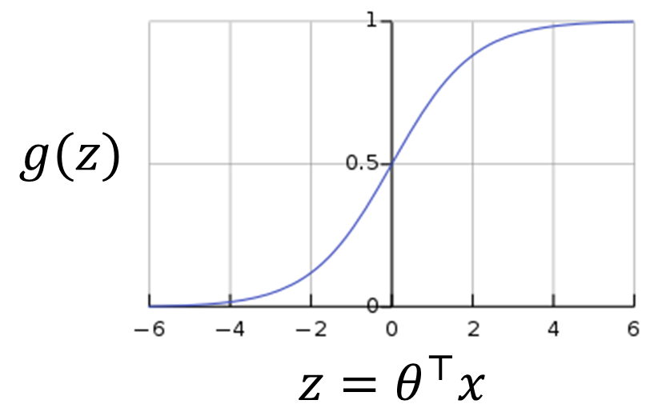
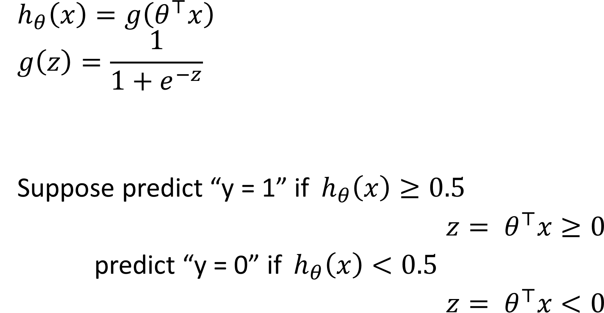
Logistic Regression: The Model

Slide 19
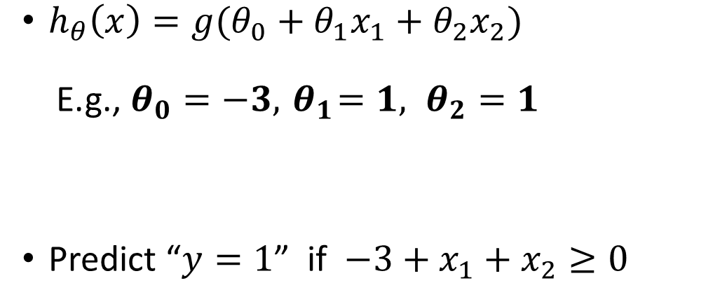
Logistic Regression: Decision Boundary
Example:
Classification of Tumor Malignant (y=1) or Benign (y=0), based on two features (Age and Tumor Size)
$h_{θ}\left(x\right)=g(θ_{0}+θ_{1}x_{1}+θ_{2}x_{2})$
E.g., $θ_{0}=−3, { θ}_{1}=1, θ_{2}=1$
Predict “$y=1$” if $−3+x_{1}+x_{2}≥0$
Age
Tumor Size

Slide 20
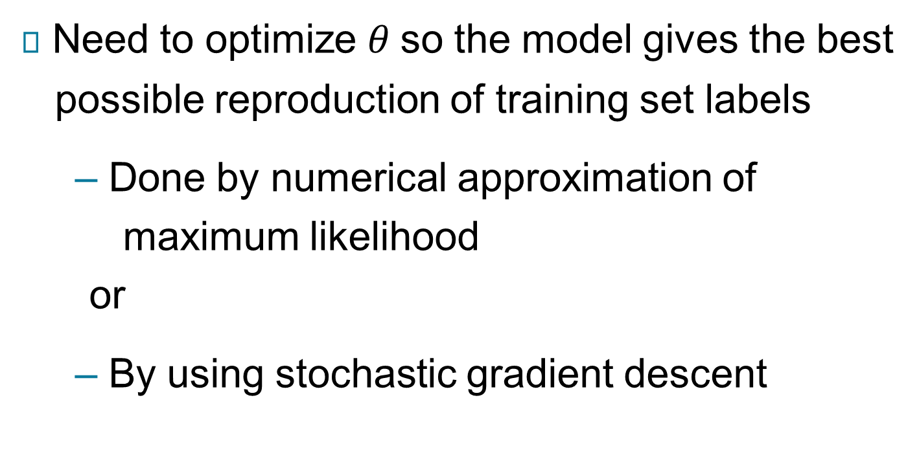
Learning a Logistic Regression Model
Need to optimize $θ$ so the model gives the best
possible reproduction of training set labels
– Done by numerical approximation of
maximum likelihood
or
– By using stochastic gradient descent

Slide 21
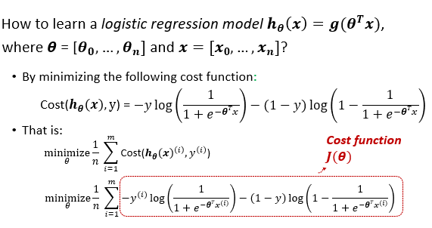
Logistic Regression: Cost Function

Slide 22
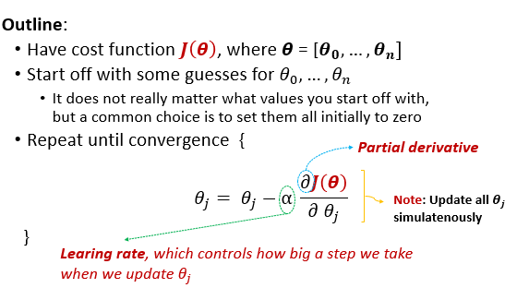
Gradient Descent For Logistic Regression

Slide 23
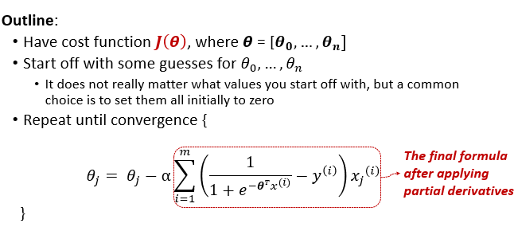
Gradient Descent For Logistic Regression

Slide 24
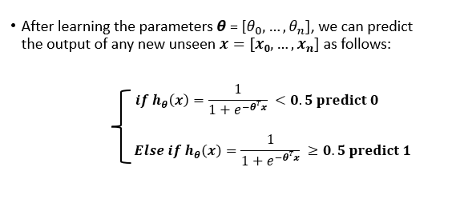
Logistic Regression: Inference after learning

Slide 25
Characteristics of Logistic Regression
The learned parameters of logistic regression can be analyzed to understand the relationships between attributes and class labels.
Because logistic regression does not involve computing densities and distances in the attribute space, it can work more robustly even in high-dimensional settings.
Logistic regression can handle irrelevant attributes by learning weight parameters close to 0 for attributes that do not provide any gain in performance during training. It can also handle interacting attributes since the learning of model parameters is achieved in a joint fashion by considering the effects of all attributes together.
Logistic regression cannot handle data instances with missing values, since the posterior probabilities are only computed by taking a weighted sum of all the attributes.

